Slide 1
Financial Aid/FAFSA
March 15, 2022
University of Virginia

Slide 2
Definition of Financial Aid

Slide 3
What is financial aid?
Financial resources intended to help pay for college expenses. Can include:
Scholarships
Grants
Loans
Work Study

Slide 4
Scholarships
Scholarships are a form of aid that students do not need to repay
Can be need-based or non-need based
‘Outside’ scholarships are awarded by groups other than a college or university. Community organizations, high schools, companies, and private donors can award scholarships to students. These often require an application.
Universities can also award scholarships. Sometimes a separate application is required, and other times students are considered based on their admission application

Slide 5
Grants
Grants do not need to be paid back
Often used interchangeably with scholarship, but generally used to describe federal, state, or institutional money
Examples:
Pell Grant
Virginia Guaranteed Assistance Program (VGAP)
Virginia Tuition Assistance Grant (VTAG)

Slide 6
Loans
Money that must be repaid- often with interest
Federal Student Loans:
Subsidized Direct Loan: no interest while the student is in school and first 6 months after graduation
Need-based
No payments until 6 months after graduation
Unsubsidized Direct Loan: will accrue interest while in school
Not need-based
No payments until 6 months after graduation
Both of these loans have a yearly and total limit
Interest rate for 21-22: 3.73%

Slide 7
Parent PLUS Loan
A federal student loan that is taken out by the parent
Can borrow up to the full cost of attendance minus other aid
Must pass a credit check
Has a high interest rate (7.28%) and origination fee (4.228%)
Can be used to make it looks like a student is receiving more aid than they are

Slide 8
Private Loans
A loan not offered by the federal government
Could be through a bank or other company
Private loans often:
Have higher interest rates
Have less flexible payment plans
Require payments to begin while still in school
Require a credit check or a co-signer

Slide 9
Work-Study
A student holds a part-time on campus job
Money is paid to student in a normal paycheck, not up-front at the beginning of the semester
Compared to an off-campus job, work study often have:
Flexible hours
Good pay
Opportunities to work with University faculty
Opportunity to gain relevant experience

Slide 10
How do Colleges Award Financial Aid?

Slide 11
Cost of Attendance
An estimate of the total cost to attend a college for one academic year.
Includes:
Direct Costs:
Tuition and fees
Room and board
Indirect Costs:
Books and supplies
Transportation
Personal Expenses

Slide 12
Example- UVA
Tuition and Fees
Living Expenses
Housing | 7,080
Dining | 5,810
Books and Supplies | 1,400
Personal Expenses | 2,814
Travel | 440
Living Expenses Total | 17,544
College of Arts and Sciences, First Year | Virginian
Tuition | 14,878
Fees | 3,358
Subtotal | 18,236
Total Cost of Attendance | 35,780

Slide 13
Expected Family Contribution (EFC)
A number calculated by the FAFSA that colleges use to determine how much financial aid you’re eligible to receive

Slide 14
Determining Financial Need
Cost of Attendance minus Expected Family Contribution = Financial Need
Financial need is what a school is trying to meet when awarding need-based aid

Slide 15
Financial Aid Package or Award Letter
A letter or page on an online portal that tells a student how much financial aid they would receive if they attended that college

Slide 16
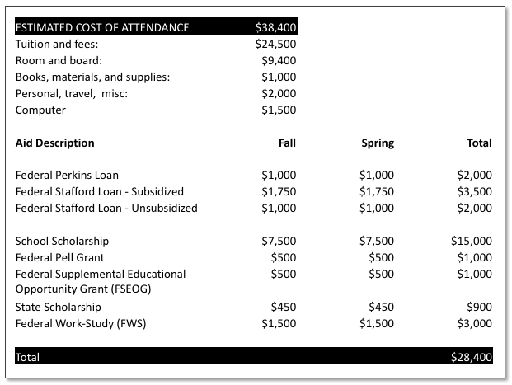
Sample Financial Aid Award Letter

Slide 17
Comparing Award Letters
Find the total cost of the school (Cost of Attendance)
Subtract money you don’t have to pay back first (scholarships and grants)
Record that number
Subtract loan money and work-study offered
The amount left over is what you would need to pay out-of-pocket (or with other resources such as private loans)

Slide 18
Net Price Calculator
A tool that can help a family estimate the amount of financial aid they would receive at a particular college or career school.
Find a school’s calculator on the Department of Education website: https://collegecost.ed.gov/net-price

Slide 19
Questions to ask/Things to Consider
Are any grants or scholarships renewable every year?
If so, what conditions does the student need to meet to keep the scholarship
Are there any other conditions or requirements for the scholarship?
How will an outside scholarship affect this award letter?
If offered work study, what is the process for finding a job, what is the pay rate and is there a minimum or maximum number of hours required?

Slide 20
APPLYING FOR FINANCIAL AID

Slide 21
FAFSA
Free
Application for
Federal
Student
Aid
A federal form that students submit to be considered for financial aid

Slide 22
FAFSA OVERVIEW
Application opens October 1st
Submitted online
Used at all colleges that award federal financial aid

Slide 23
FAFSA Process
Create an FSA ID
- A username and password
- Used to log into federal financial aid websites
- Used as a digital signature
Both the student and one parent need to create an FSA ID
Be sure to write down your username and password and save it somewhere you will remember!

Slide 24
FAFSA Process- Complete the FAFSA
Student demographics
DOB, SSN, high school, colleges
Dependency determination
Is the student dependent (will they need to include parent information on the FAFSA)
Parent demographics
Marital status, SSN, DOB, address
Parent financial information
Tax information from two years before school year for which you are applying
Assets, bank account balances, investments
Do not need to include retirement savings (such as 401(k)
Student financial information
Same as parent (many students have no or less financial info)

Slide 25
What happens next?
May be selected for verification
Info is sent to colleges. Each college you are accepted to will send a financial aid letter
If you apply to any additional colleges, be sure to add them to your fafsa

Slide 26
FAFSA Tips
Be sure to triple check information such as social security numbers, birthdays, and name spelling
Be sure to watch your email, looking out for anything from federal student aid or the colleges you applied to
The blue question mark icon on each page can provide additional information if you are unsure how to answer a question
The FAFSA needs to be submitted every year. Mark your calendar so you don’t forget to apply next year!

Slide 27
CSS Profile
A financial aid application designed by College Board
Used by some colleges when awarding institutional (school) financial aid
Fee to submit ($25 for the first, $16 for each additional; fee waivers are available)
Schools in Virginia:
William and Mary
University of Richmond
University of Virginia
Washington and Lee
Patrick Henry College
Other Colleges such as:
Georgetown
Duke
NYU
Yale
Full list available at cssprofile.collegeboard.org

Slide 28
Deadlines

Slide 29
It is extremely important that you submit the FAFSA ( and if needed CSS Profile) by the deadline given by the college
If you don’t, you may:
Receive your financial aid package late
Receive less aid

Slide 30
There are schools in Virginia with priority FAFSA deadlines as early as November 1st. Be sure to check with all of the schools you are interested in and be sure to submit your FAFSA by that deadline!

Slide 31
Scholarships

Slide 32
How to Find Scholarships
Many scholarships can be used at technical/trade school or community college!
Your local community
School, church, businesses, community organizations
Scholarship Search Engines
https://bigfuture.collegeboard.org/pay-for-college/scholarship-search
https://www.goingmerry.com/
https://www.fastweb.com/
National Scholarship Programs
QuestBridge
Jack Kent Cooke

Slide 33
Questions?
Julie Kusnerik
JAK8BZ@virginia.edu
Resources:
Federal Student Aid website: https://studentaid.gov/
https://finaid.org/
Student Financial Services: sfs.virginia.edu

